Slide 1
Guidelines for Assignment 2

Slide 2
Goals for Assignment 2
Analyze ~22.57 Million data points
Assignment 2 helps
  To learn how to use Java and SQL together
    How to connect to remote database server
    How to write query to get data from the remote database server
  To design a stock investment strategy
    When to buy a stock
    When to sell a stock
    When to do nothing

Slide 3
Connect to MySQL Sever
Database server: mysql.cs.wwu.edu
Database:
johnson330
User name and passwords
  Provided

Slide 4
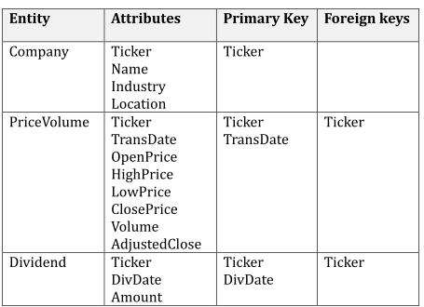
Database Schema

Slide 5
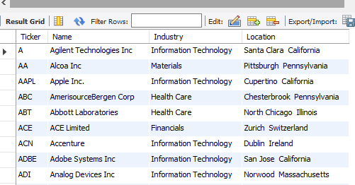
select * from Company limit 10;

Slide 6
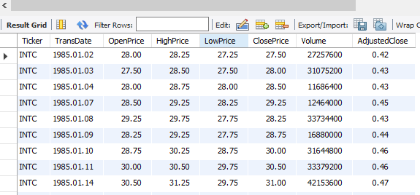
select * from PriceVolume where Ticker = 'INTC' limit 10;

Slide 7
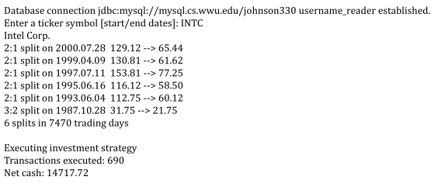
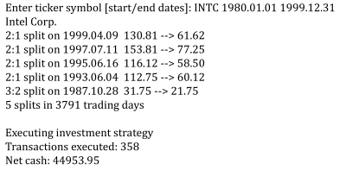


Sample output
Transaction executed
= How many buy or sales you have done in this time period

Slide 8
How your program should proceed
Step 1
Step 2.1 to 2.4
Step 2.5 to 2.10

Slide 9
Two Queries
select Name
from Company
where Ticker = ‘INTC’;
select TransDate, OpenPrice,
HighPrice, LowPrice, ClosePrice
from PriceVolume
where Ticker = ‘INTC’
order by TransDate DESC;

Slide 10
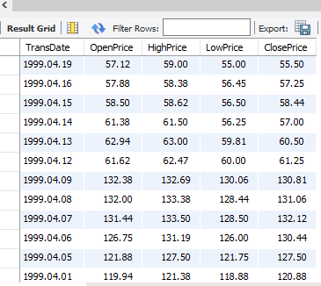
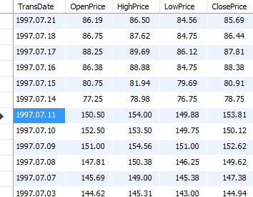
Split Adjustment for INTC (Step 2.5):
A Simple Way
……………………
……………………..
Divide by 2 for split adjustment
Divide by 2 again
for split adjustment
……………………
……………………..

Slide 11
Split Adjustment for INTC (Step 2.5):
A Smart Way
……………………
……………………..
Divide by 2 for split adjustment
Divide by 4 for split adjustment
……………………
……………………..

Slide 12
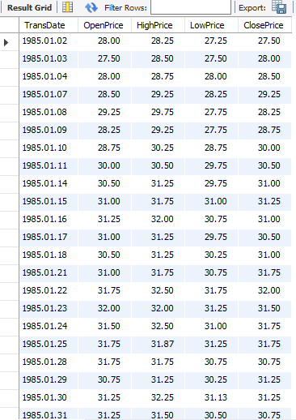
Investment Strategy for INTC
(Now Ascending order): Step 2.6 to Forward
……………………
……………………..
……………………
……………………..

Slide 13
The Deque Interface in Java
Pronounced as deck
A double-ended-queue.
Implements both stacks and queues at the same time.
Deque Methods
Type of Operation | First Element (Beginning of the Deque instance) | Last Element (End of the Deque instance)
Insert | addFirst(e) | addLast(e)
Remove | removeFirst() | removeLast()
Examine | getFirst() | getLast()

Slide 14
Investment Strategy for INTC
(Now Ascending order): Step 2.6 to Forward
……………………
……………………..
d = Trading day,
d+1 = the next trading day,
d–1 = the prior trading day
close(d) = closing price for day d
open(d) = opening price for day d
Step 2.7
Maintain a moving average of closing prices over a 50-day window.
For day d, the 50-day average is the average closing price for the 50 previous trading days (days d-50 to d-1).
Step 2.8
If less than 51 days of data, no trading
Net gain of zero
Repeat from beginning (step 2.1) to get next user input.
Step 2.9
If more than 51 days of data, compute 50-day average for the first fifty days.
From day 51 through the second-to-last trading day, execute following strategy (next slide)
……………………
……………………..

Slide 15
Investment Strategy for INTC
2.9.1 Initially
cash = 0.0 and number of stock=0;
2.9.2 Buy criterion
If close(d) < 50-day average and
(close(d) / open(d) <= 0.97)
buy 100 shares of the stock at price open(d+1).
2.9.3 Sell criterion
If shares >= 100 and
open(d) > 50-day average and
(open(d) / close(d-1) >= 1.01),
sell 100 shares at price (open(d) + close(d))/2.
2.9.4 Transaction Fee
For either a buy or sell transaction, cash is reduced by a transaction fee of $8.00.
2.9.5 If neither the buy nor the sell criterion is met, do not trade on that day.
2.9.6 Regardless of trading activity, update 50-day average to reflect average over last 50 days, and continue with day d+1.
……………………
……………………..

Slide 16
Investment Strategy for INTC
Step 2.10
After processing data through second-to-last day, if there are any shares remaining, on the last day add open(d) * shares remaining to cash to
account for the value of those remaining shares (No transaction fee applies to this).
……………………
……………………..

Slide 17
Sample output one more time
Transaction executed
= How many buy or sales you have done in this time period

Slide 18
Things to remember
Submission Instructions
  Submit source code only.
  File name which contains main method should be Assignment2.java
  If more than one java files:
    Keep all java files in a single folder.
    Folder name = your last name
    Zip the folder and name it Assignment2.zip
    Upload the Assignment2.java/ Assignment2.zip on canvas.
Obey the constraints mentioned in the pdf file
Should have good design and style
If something goes wrong, look at the “Hints” section first (in the pdf file) to see whether there is any hint

Slide 19
Point Distribution
0.5 point
1 point
1 point
2.5 point
35 – Will check with 7 separate companies/date ranges (5*7)
3 – Output is correctly formatted.
3+3 – Program obeys 2 constraints
5 – Program has good design and style
1 – File name follows the rules.

